Slide 1

Tlock Project
Text Locker Project

Slide 2
CONTENT
01
What is Tlock?
02
What are the Advantages For Tlock?
03
What are the disadvantages For Tlock?
04
Project Image Preview

Slide 3
01
What is Tlock?
T-lock is a project that encrypts text with 48 layers of encryption and it can encrypt text and decrypt it. It is written in Python. It can also encrypt and decrypt voice, text, Python code and JavaScript Code, And more.

Slide 4
02
What are the advantages of Tlock?
You can run it without installation
It can encrypt and decrypt text and Python code by 48 layers of encrytion
It can encrypt and decrypt video, audio and images by 12 layers of encrytion
Easy to use

Slide 5
03
What are the disadvantages of Tlock?
Slowness of encryption
But I’m trying to find solutions to solve this problems by using multiprocessing and multithreading with keeping the encryption levels the same with using less demanding CPU and RAM encryption algorithms

Slide 6
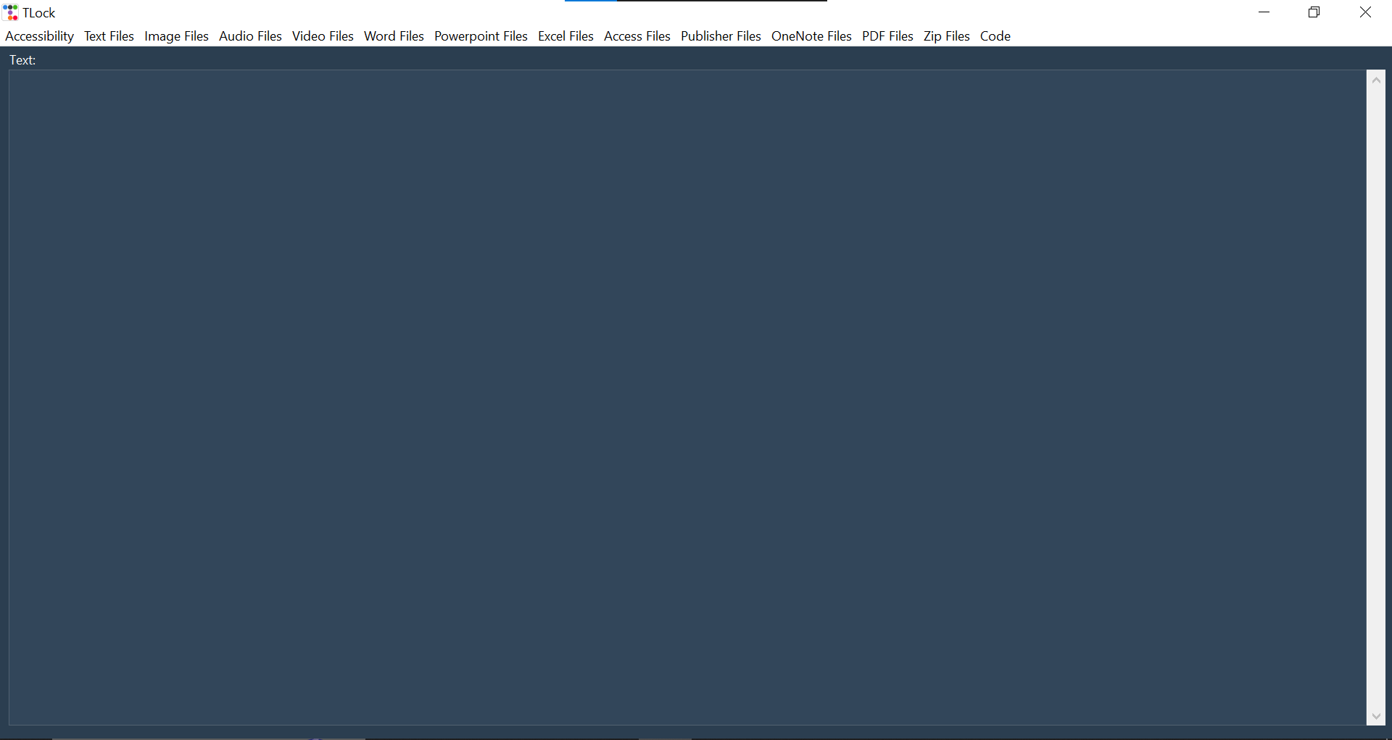

Slide 7
Thanks for listening!
Presented By:
Ahmed Omar Saad

